Slide 1

Published Research Metrics
Kevin Chiv

Slide 2
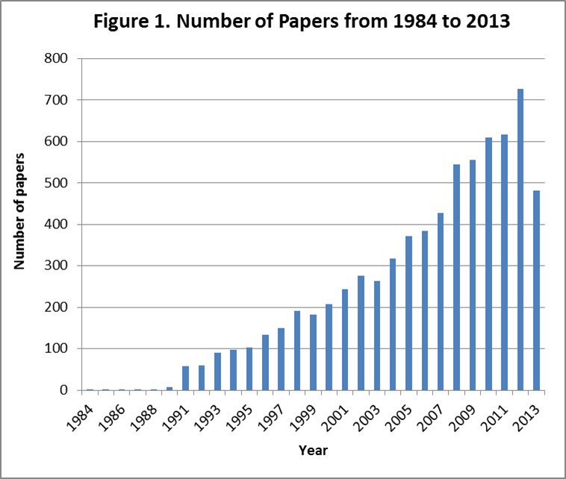
Problem:
Too many papers
Objective:
Create better metric for measuring impact factor of published research

Slide 3


Slide 8
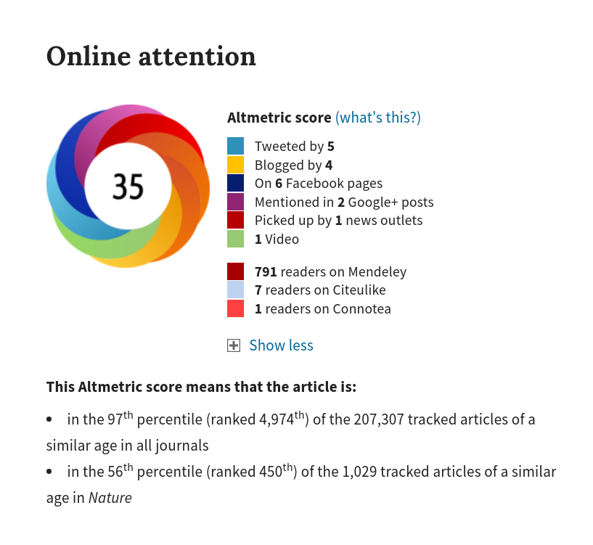
Dependent:
Altmetric
Independent:
Number of citations,
number of authors,
& more

Slide 9
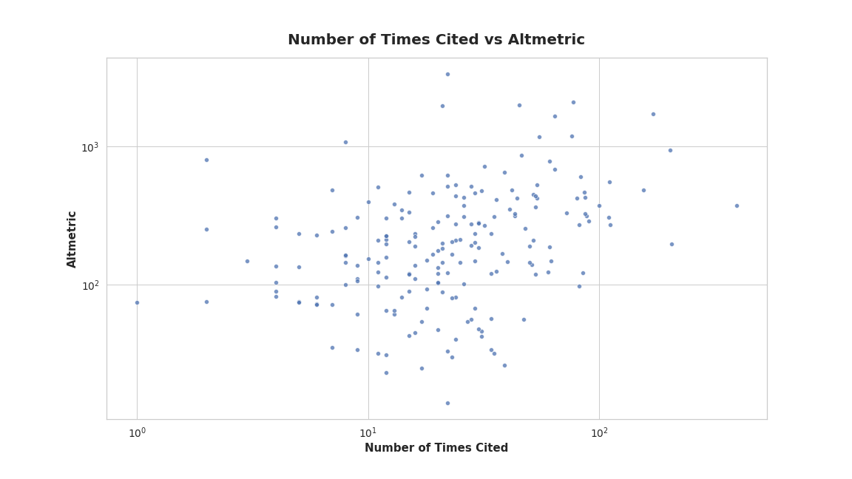

Slide 10



K-Fold Cross Validation
With 5 Different Regression Models

Slide 11
Best Linear Regression Model: Ridge
Significant Features: |  | Coefficients:
log(Mean Number of Times Authors Were Cited) |  | -0.083568
Top 20 Ranked U.S. University |  | 0.10435
Difference Between Current Date and Date Published |  | 1.29793
log(Number of Times Article Was Cited Adjusted by Year) |  | 0.66572
log(Number of Paper Authors) |  | 0.18210
log(Mean h-index of First 5 Paper Authors) |  | 0.09004
log(Mean i10-index of First 5 Paper Authors) |  | 0.07635
Training Mean R^2: | Standard Deviation of Training R^2: | Test R^2:
0.535 | .050 | 0.520

Slide 12
Recommendations
Search for relevant top research institutions
Follow high-profile individuals on Google Scholar
Consider the date the paper was published

Slide 13
Thank You!

